Slide 1
Host Microbiome and aging using 16s approach
Guillermo G. Torres
Ph.D. student
Genetics of Human Longevity Group

Slide 2
About the data
 | All | Males | Females
BSP/SPC | 133 | 68 | 65
FOC | 101 | 49 | 52
AGI | 9
Samples | 241 | 117+agi_M | 117+agi_F

Slide 3
About the data
A whole genome sequencing (metagenes) was performed to12 samples using our budget plus 9 from centenarians.
FOC_236, FOC_253, FOC_291, FOC_306, FOC_341, FOC_346, FOC_366, BSPSPC_168, BSPSPC_462, BSPSPC_468, BSPSPC_475, BSPSPC_489.
** Fiete, are These included in the whole batch of 54? or are extra.
We are going to use 54 more metagenomes from FOC/SPC batches for later analysis. From this 47 sequencing libraries got so far.

Slide 4
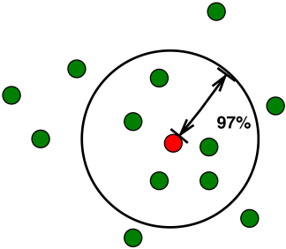
Working with data
Sequences are binned into OTU according sequence similarity.
 | No. Seqs.
Raw seqs. | 11674227
Quality Control | 8573796
OTUs | 203000
Operational Taxonomic Unit (OTU)

Slide 5
General overview
Alpha diversity

Slide 6
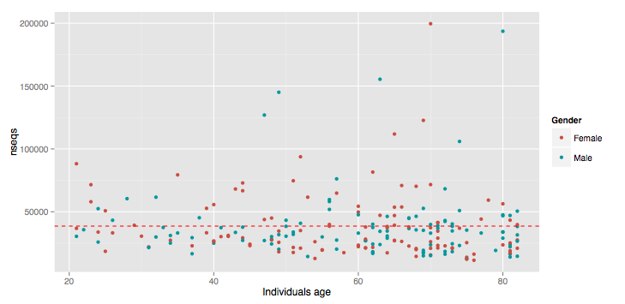
Reads per sample

Slide 7
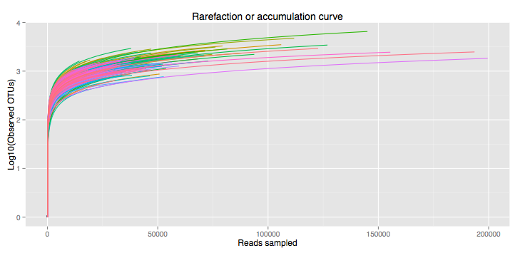
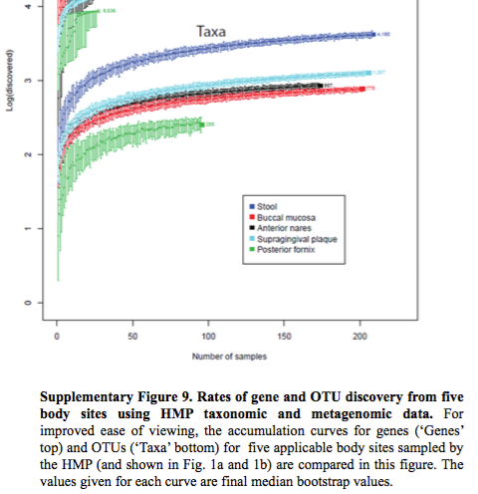
Rarefaction or cummulative curves
The Human Microbiome Project Consortium 2012 b

Slide 8
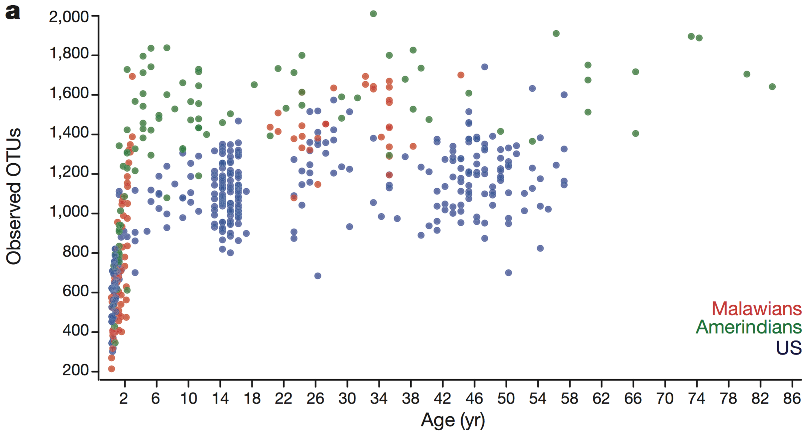
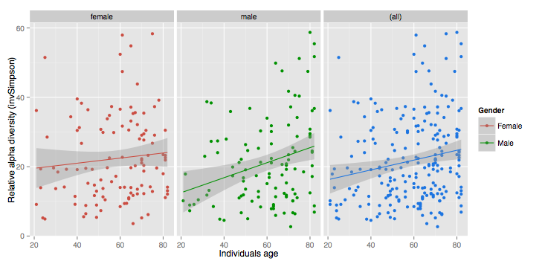
OTUs per sample
Yatsunenko et al. 2012
222 indv.
110 Female
112 Male.

Slide 9
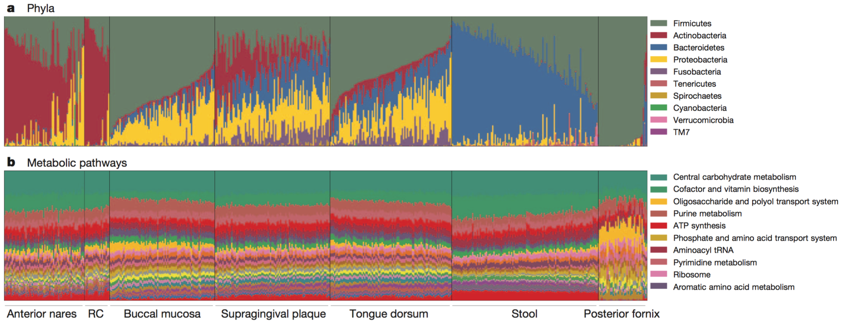
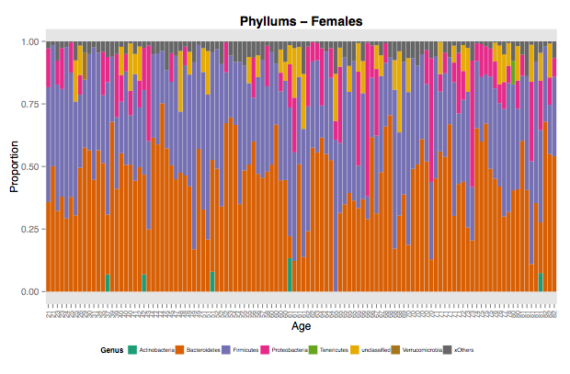
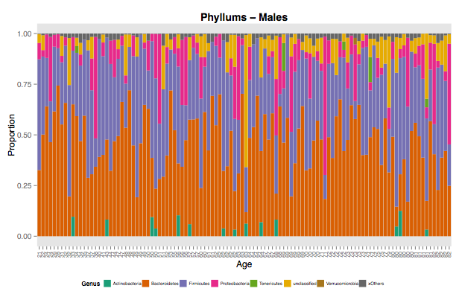
OTU classification
The Human Microbiome Project Consortium 2012; Age: 18 - 40, mean age of 27 sd. 5
All reads binned to certain OTU = 8,573,796
Reads binned to Unknown Bacteria = 638,980
Anteror
nares
Buccal
mucosa
Supragingival
plaque
Tongue
dorsum
Stool
Posterior
formix

Slide 10
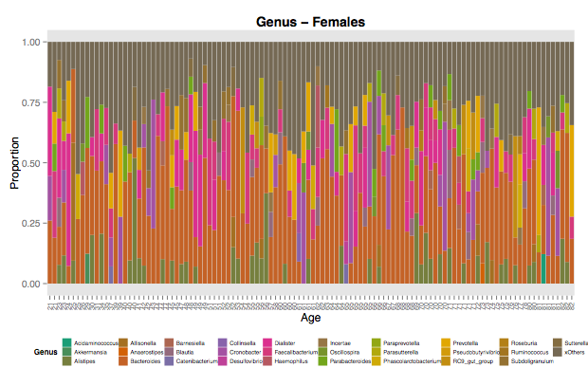
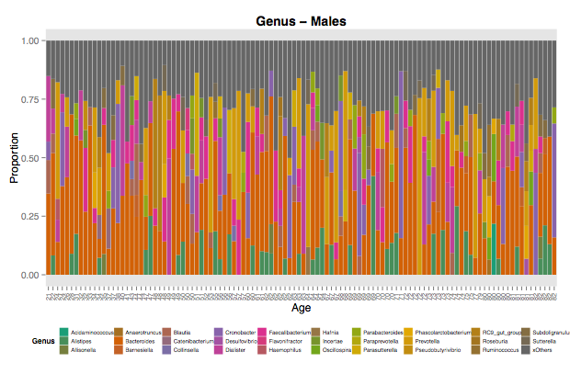
OTU classification
Bacteroides genus dominating.

Slide 11
Networks approach

Slide 12
workflow
In ecology the competition between organisms could be seen from their presence abundanc.
Patterns of co-occurrence due to ecological relationships (mutualism, comensalism, etc.) or just niche overlapping.
The interactions will be represented as a network (mathematical representation of real-world complex system).
Use the age variable to represent network serial time.
Calculate network global and local parameters to understand the dynamics of the organism interactions.

Slide 13
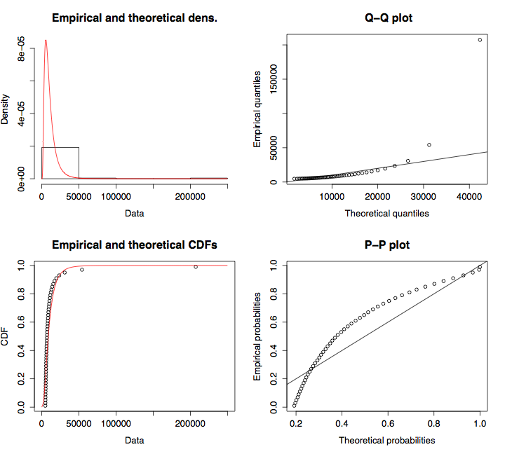
Data treatment
Raw data does not fit well to log-normal distribution

Slide 14
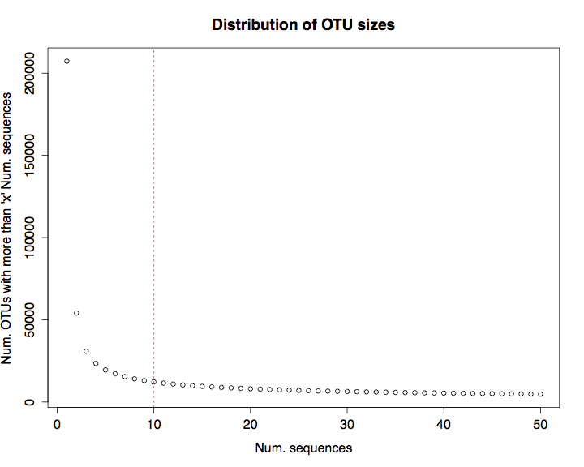
Data treatment
Many OTUs low covered
We estimated the population size of each sample based on rare OTUs using Chao and ACE estimators. According to ACE, 85% of the samples estimate less than 12000 OTUs. Congruent with rarefaction.
Around12K OTUs with are formed with 10 read counts or more.
OTU size threshold = 10 read counts

Slide 15
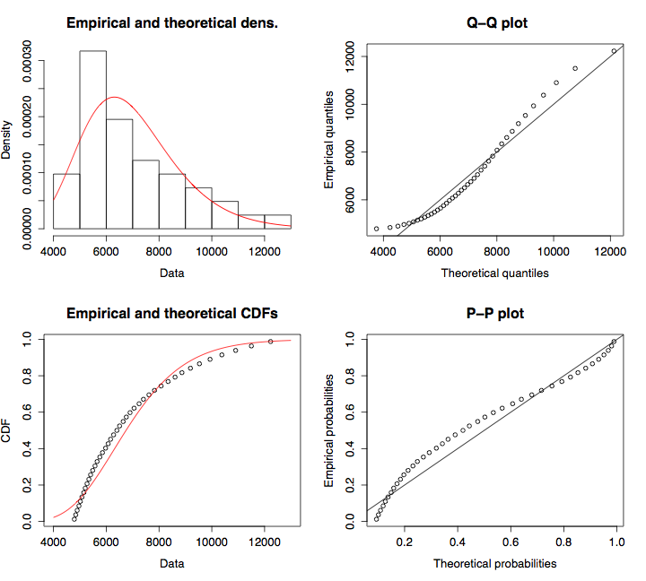
Data treatment
Raw
Information lost = 3.3% - Trimmed
After trimmed OTUs with fewer read counts than 10 fits better to log-normal. Probably better distribution adjustment would be to free-scale

Slide 16
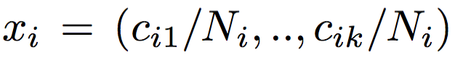
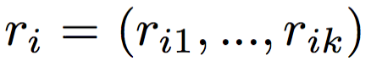
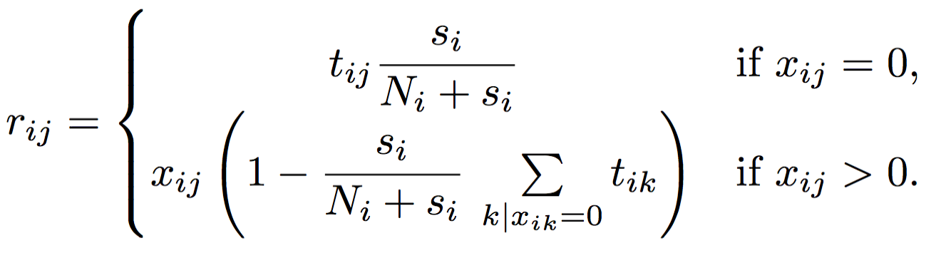
Data treatment
Most OTU appears in a few individuals with low abundance, and zero values dominate most count values. Non-sufficient sampling effort.
Data structure falls into special data class named as compositional data (Aitchison 2003)
For replacing the zero counts by a proper value, we managed the data using the Bayesian- multiplicative approach (Pawlowsky-Glahn et. al. 2011-chap4).

Slide 17
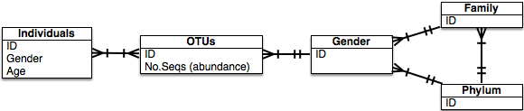
Data structure
- Construction of OTU correlation matrix. ~12K OTUs found.
OTU filtration; assessed OTUs will be those that occurs in at least 15% of the samples. This reduction left 300 OTUs
filtered OTUs may have accounted for particularities of each sample.

Slide 18
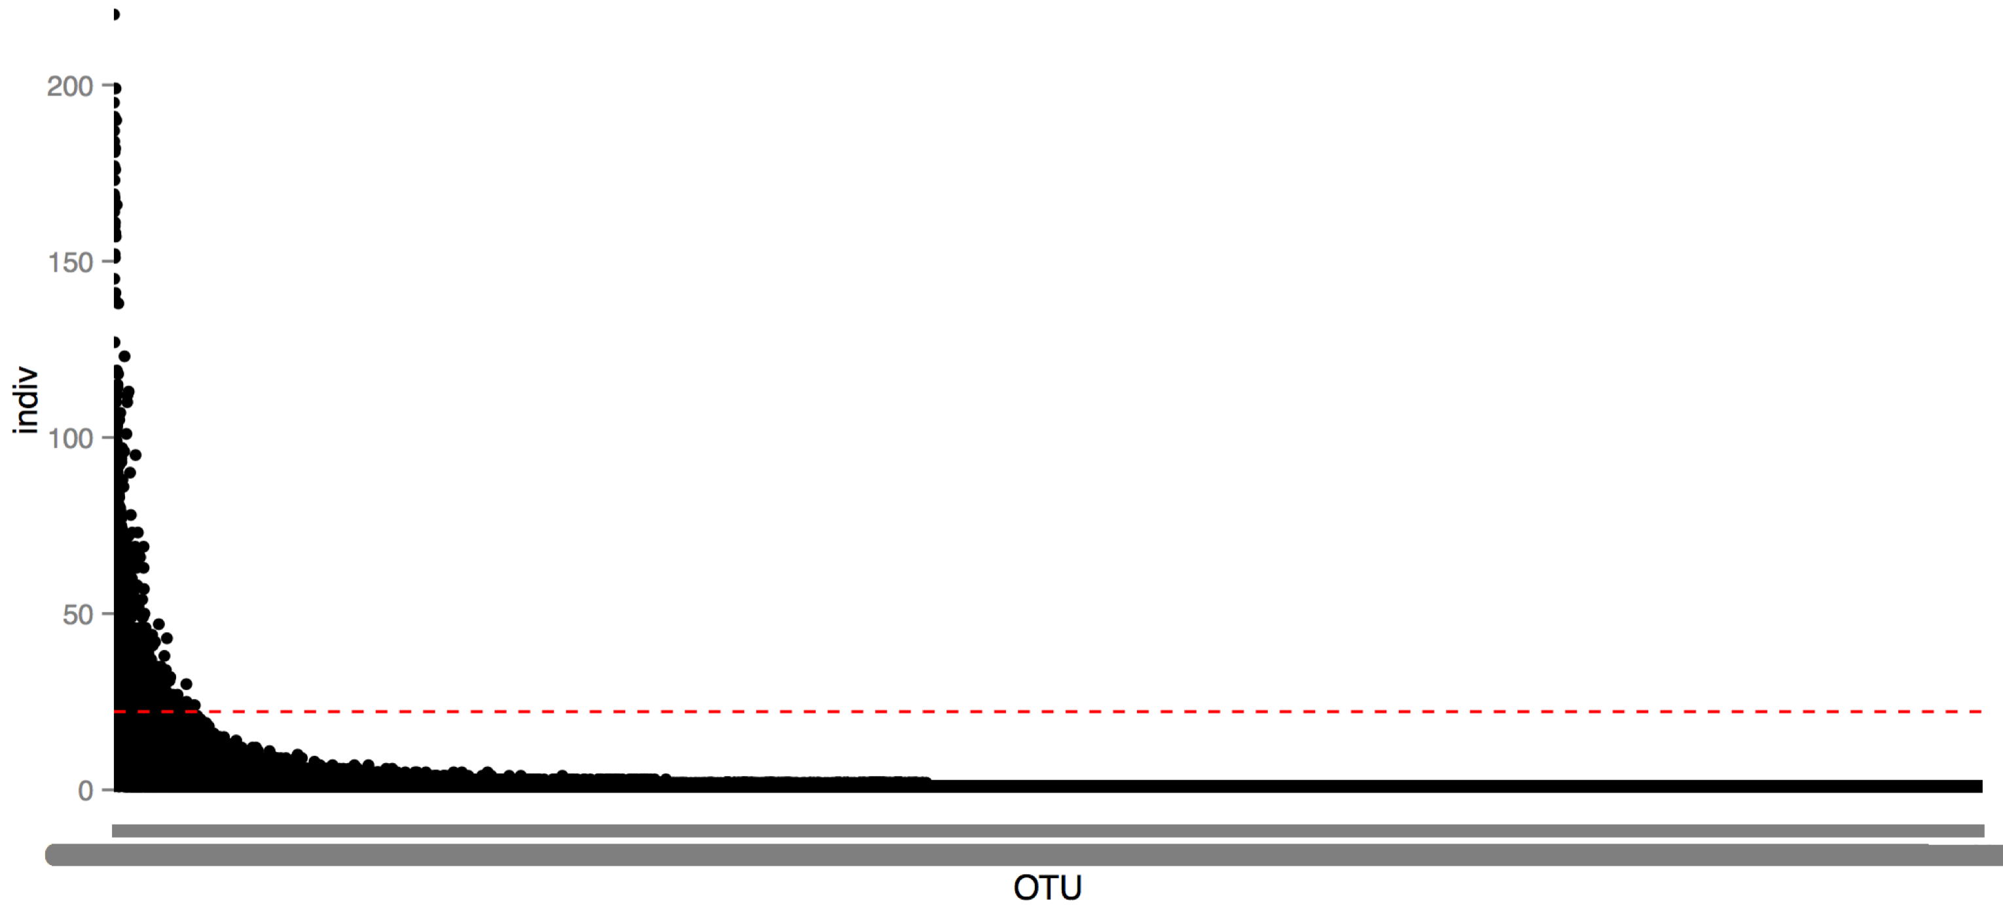
OTU in individuals
This suggest that almost every subject habitat is characterised by specific taxa profile. a signature may be? - which is congruent with other studies
The Human Microbiome Project Consortium 2012

Slide 19
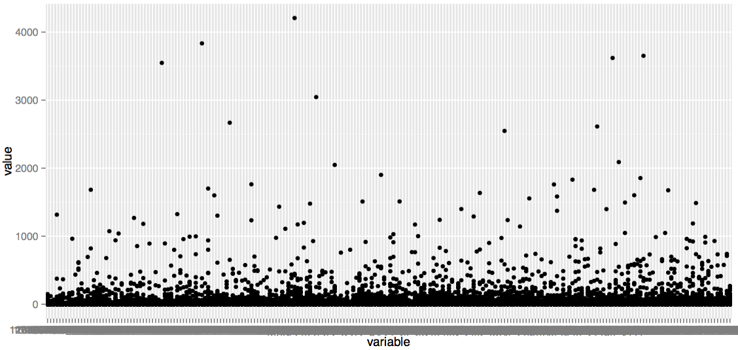
OTUs discarded
Get more deep into this later.
Num. Seqs.
OTUs

Slide 20
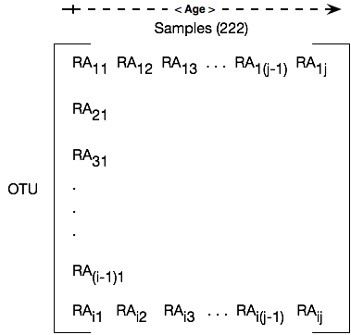
Data structure
Where RA means the transformed relative abundance of the OTU in an individual.
Due to data follows a compositional data statistics we use log-ratios for further analysis (Aitchison 2003).

Slide 21
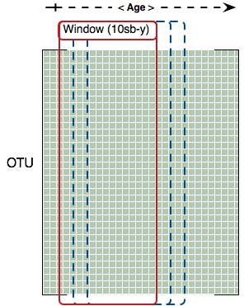
Correlation matrix
Using a sliding window we generates multiples correlation matrixes.
Later evaluation as time series.

Slide 22
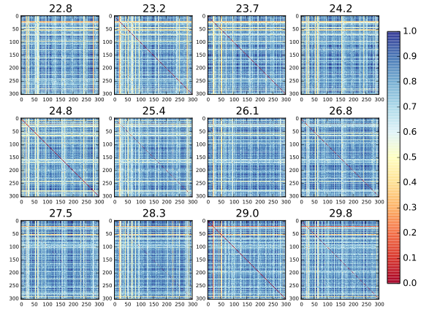
Correlation network matrices

Slide 23
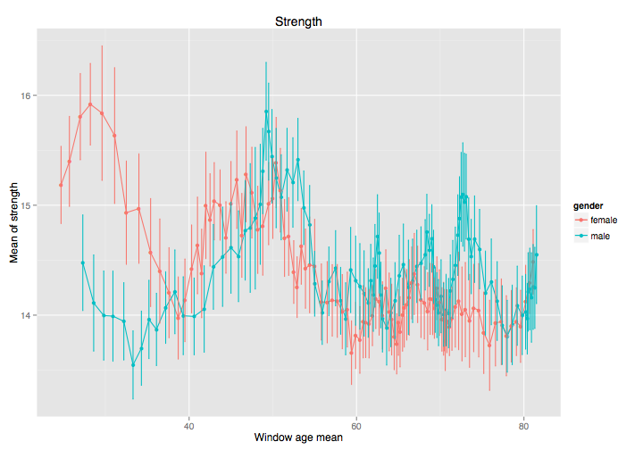
Network metics
Nodes with high degree are interacting, structurally or functionally.
Elderly loose high connected nodes and gender convergence.

Slide 24
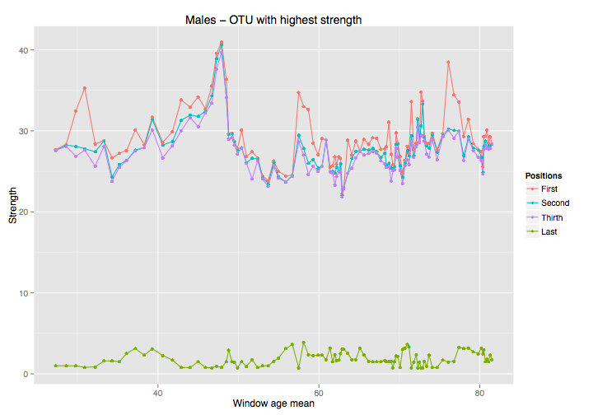
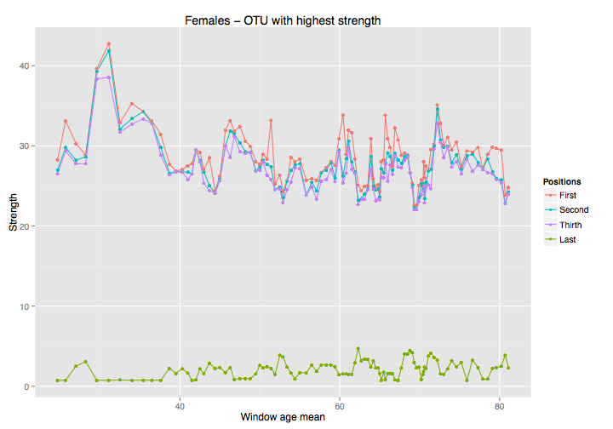
Network metics
Hubs between males and females look a bit different. Get in deep later.

Slide 25
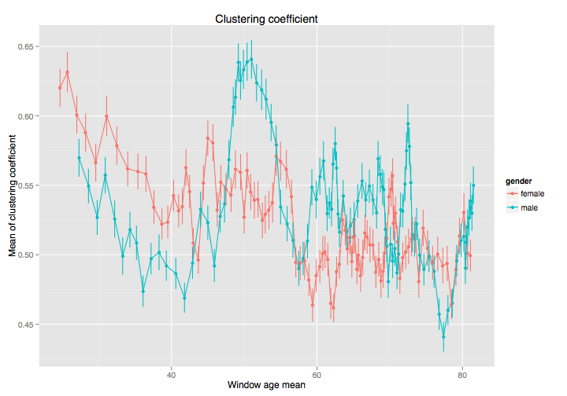
Matrice metics
The level of clustering between male and female are different specially around 50’s.

Slide 26
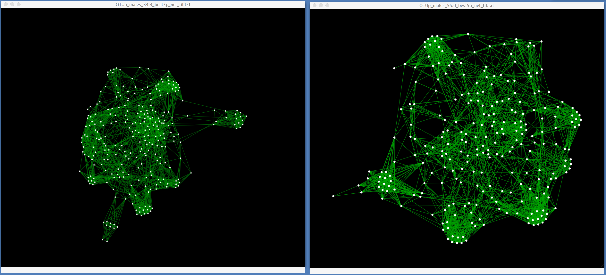
Topologies of the network for males with mean age of 34 (left) and 55 (right). Contrasting clustering and strength values.

Slide 27
Ongoing work…
Our first approach to generate the correlation matrixes using
log-ratios and cosine distance give us many spurious values therefore we are exploring:
John Baines suggests to use Sparcc algorithm (2012) and relative ones (REBACCA - 2015) to generate the correlation matrix.
We are exploring to generate a Covariance matrix to assess OTUs relationships using SPIEC-EASI algorithm (2015). (more complex than Sparcc)

Slide 28
Next steps
Once the “relationship” matrices are done, collaborative partners from Spain ( Dr. Javier Buldú, at the Center for Biomedical Engineering of the Technical University of Madrid) will assist me to analyze this time series framework to model the dynamics in microbial relationships through aging.
For most relevant microbial clusters we are going to generate its possible functional profile, and then with the assistance of Christoph Kaleta, we will perform a flux balance analysis to know whether the cluster has a functional dependency or not.

Slide 30
Extra…

Slide 31
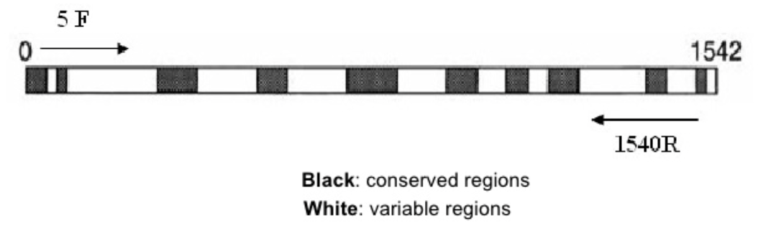
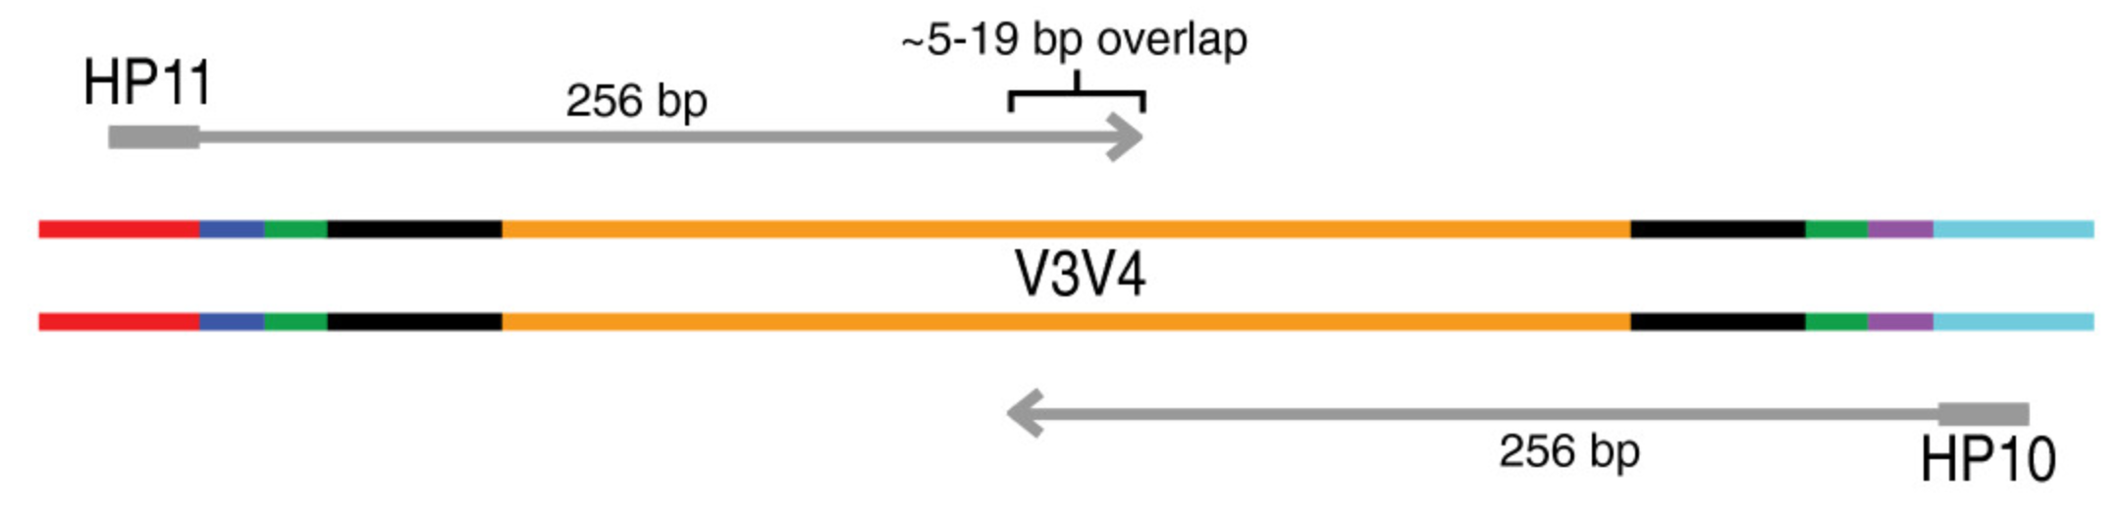
Where data comes from?
16S rRNA
Fadrosh et al. 2014
16S gene - exists universally among bacteria
Highly conserved regions (V3-V4)

Slide 32
Working with data
Operational Taxonomic Unit (OTU)
16S variability rate has been determined experimentally:
≥ 99% Species level
≥ 97% Genus level
≥ 95% Family level

Slide 33
Working with data
Abundance
Richness = No. OTUs
 | No. Seq.
OTU_1 | 50
OTU_2 | 20
OTU_3 | 300
OTU_4 | 100
Each sample has one
OTU profile
Alpha Diversity

Slide 34
Identify Microbial composition with
regard to age
Data combines quantitative and qualitative variables besides multiple environmental factors (OTUs).
Multivariate statistics is one alternative.
Classification
Placement of sample units into groups
Ordination
Arrangement or ‘ordering’ of sample units along gradients.

Slide 35
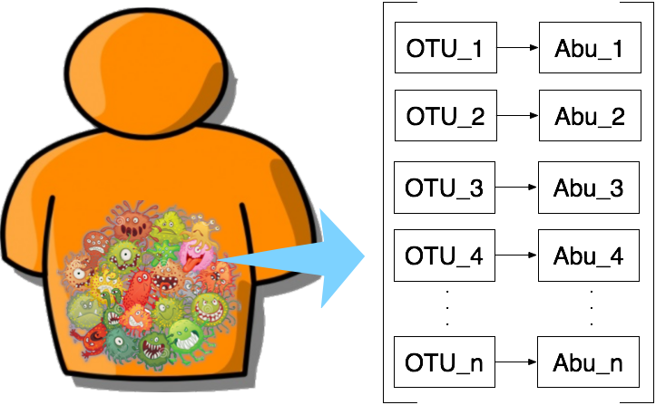
OTU abundance change through age?
Is the richness changing through age?
Which taxa are changing?

Slide 36
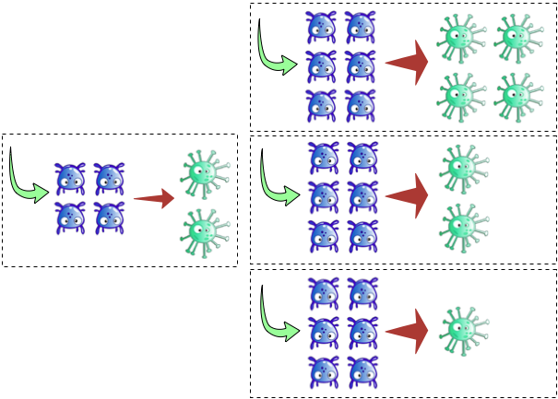
Syntrophy = Cross-feeding, one species lives off the products of another species

Slide 37
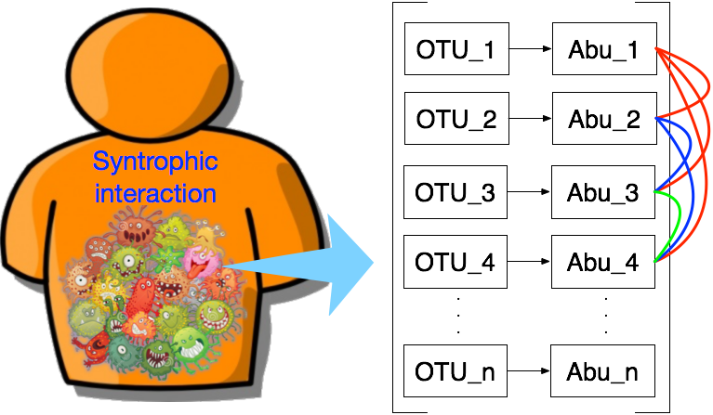
Syntrophy = Cross-feeding, one species lives off the products of another species
The relationship will be measured in terms of the abundance.
Then following up through age.

Slide 38
Characterise Relationships among microbiota
Complex network analysis.
Holistic approach which allows explore the interactants and their interaction:
Micro-scale (OTUs)
Meso-scale (Group of OTUs)
Macro-scale (Net)

Slide 39
Results
 | No. Seqs. | No.
Raw | 11674227
Quality Control | 10158262
Contigs | 5079131
Quimeras | 3047478.6
OTUs | 2031652.4 | 322000

Slide 40
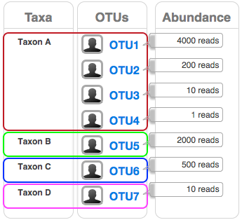

Slide 41
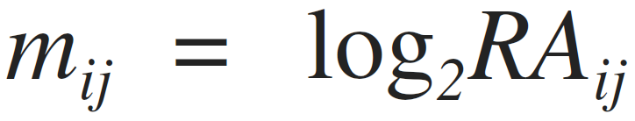
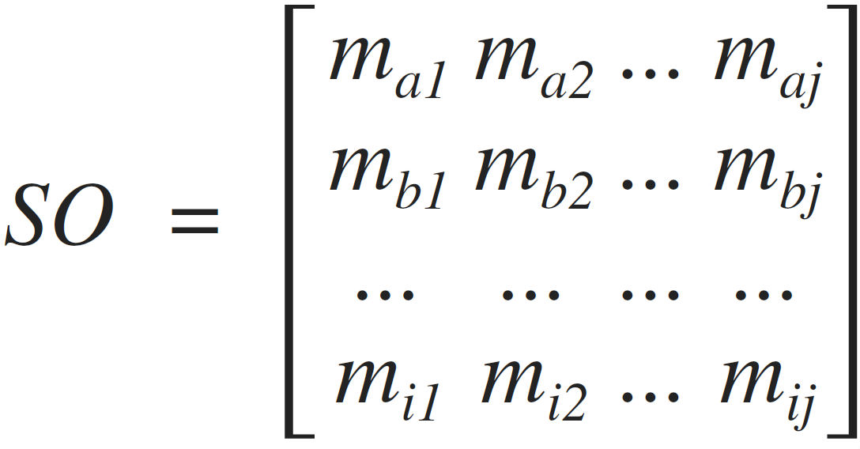
Data transformation
By column, RA values are transformed to lineal scale
1) linearisation:

Slide 42
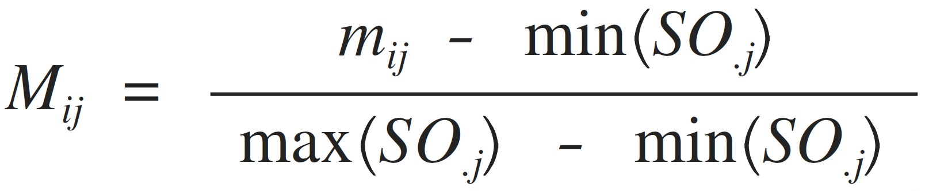
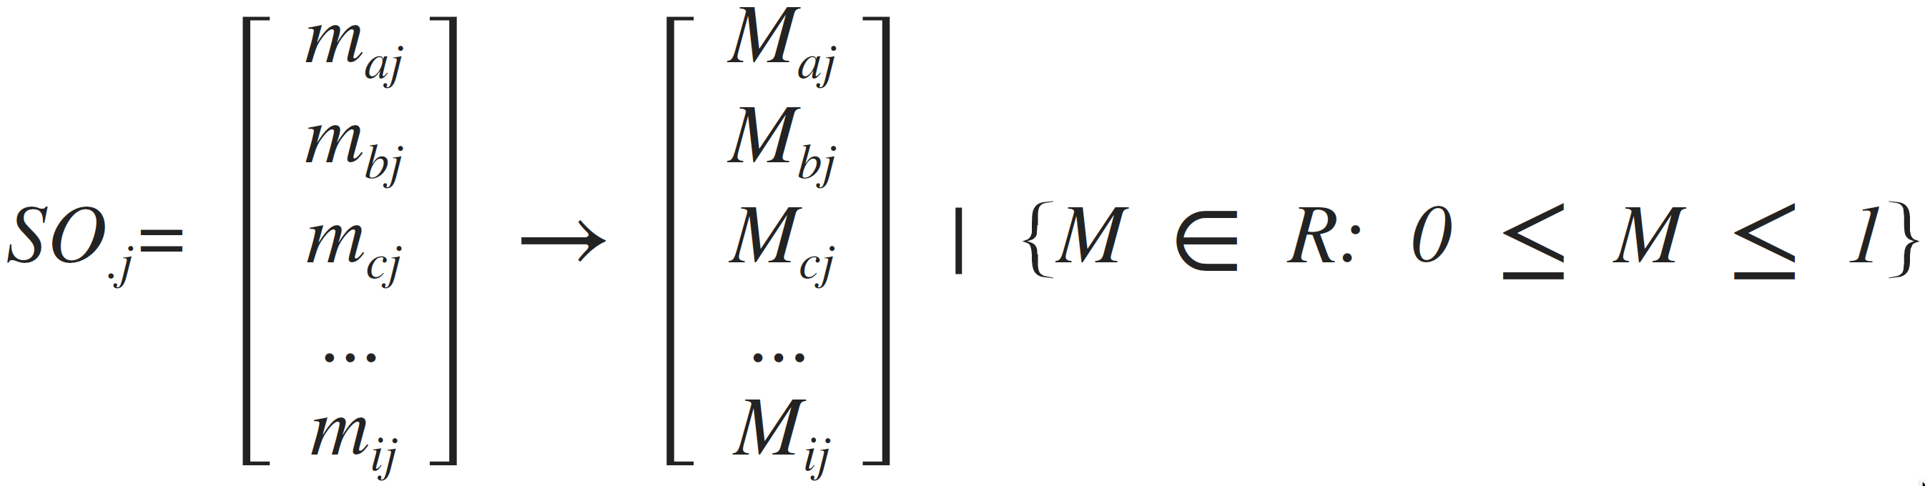
Data transformation
By column normalisation. m values are transformed into 0 - 1 scale:
2) Individual normalisation:

Slide 43
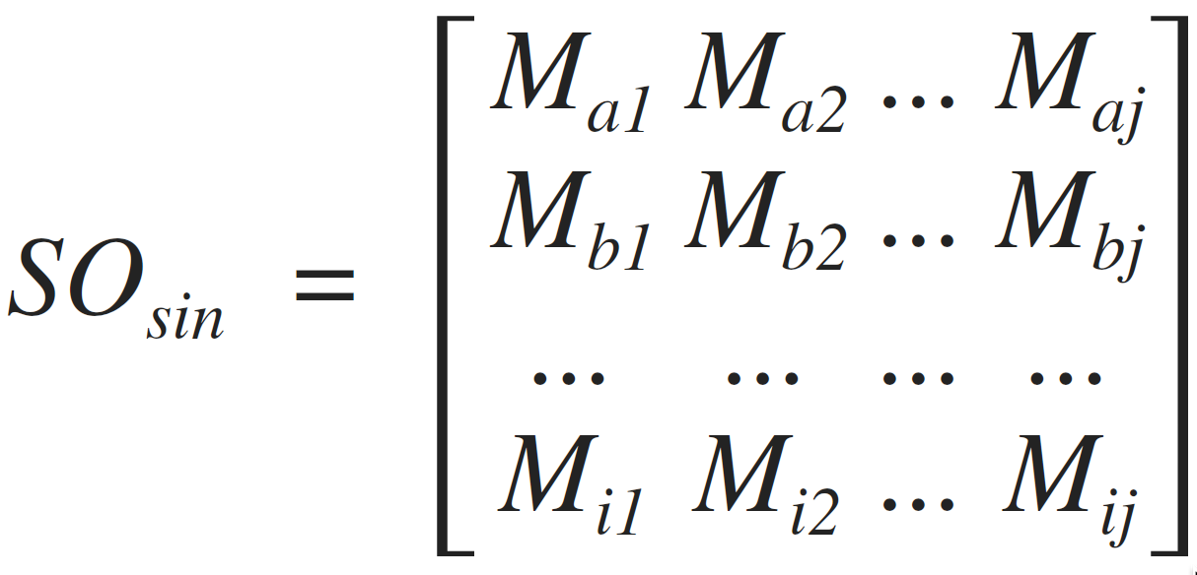
Data transformation

Slide 44
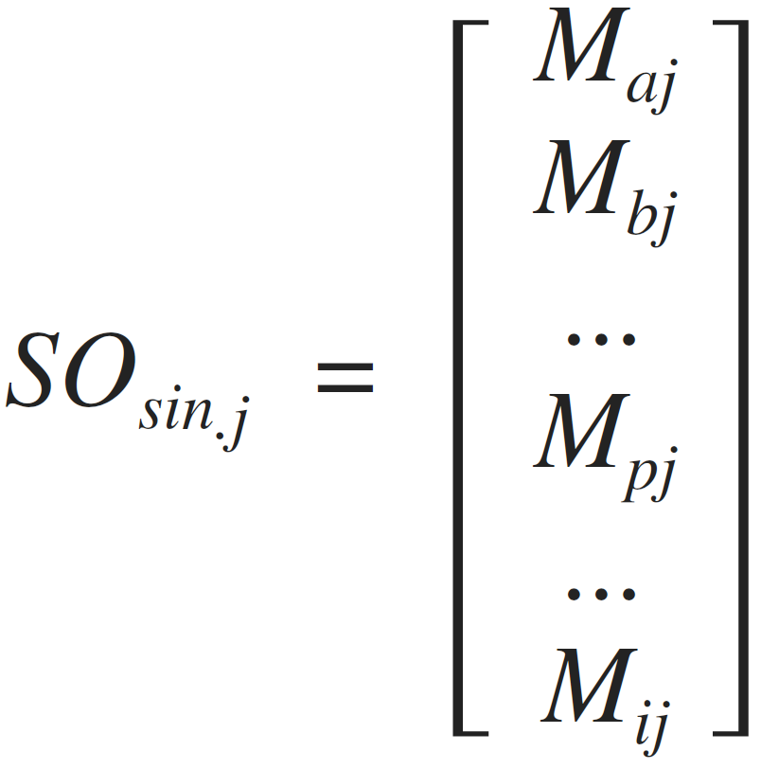
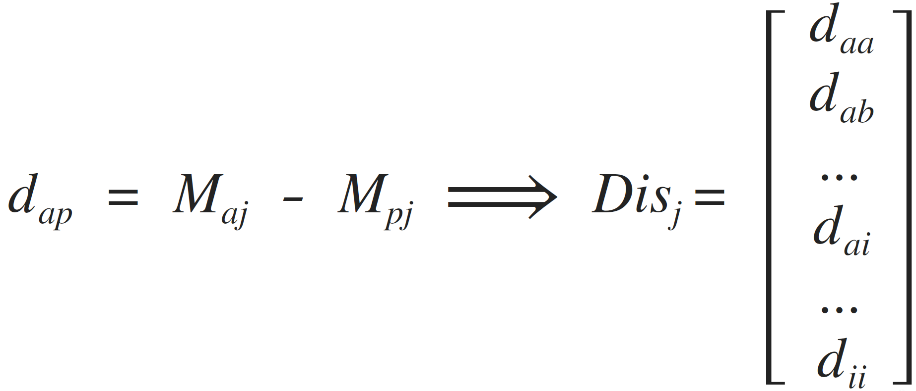
OTU - OTU correlation
"Maj" represents the abundance of the OTU "a" in the organism "j" then:
Calculate all the OTU permutations
Calculate the distance "d"of each permutation

Slide 45
SOsin

Slide 46
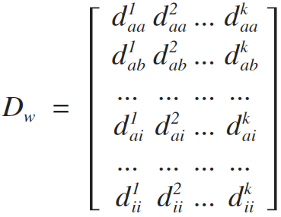
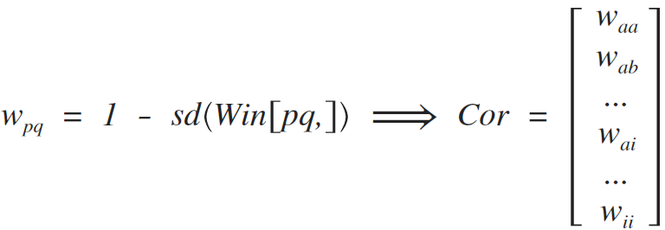
OTU - OTU correlation
Dw matrix contains distance vectors (Dis.j) of individuos in slide window.

Slide 47
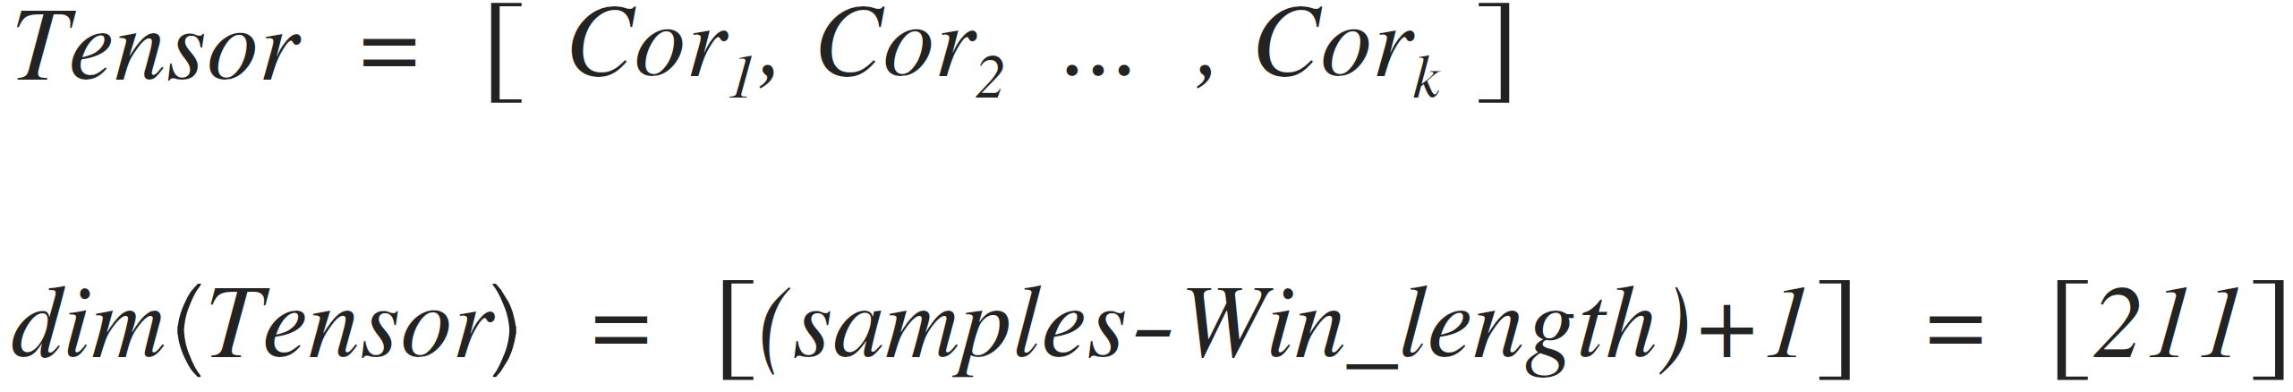
OTU - OTU correlation

